Slide 1
Chapter 9:
Behavioural Design Patterns

Slide 2
Objectives
To introduce behavioral design patterns
  Interpreter
  Iterator
  Mediator
  Observer
  State
  Chain of Responsibility
  Command
  Template

Slide 3
Interpreter Design Pattern
Design Purpose
  Interpret expressions written in a formal grammar.
Design Pattern Summary
  Represent the grammar using a Recursive design pattern form: Pass interpretation to aggregated objects.

Slide 4
Interpreter Design Pattern (Cont’d)
There are two parts relating to the Interpreter design pattern:
  Parsing
    The process of converting an input, usually a string, into a tree of objects consistent with the class model.
  Interpreting
    Performing useful functionality with the result of the parsing phase.

Slide 5
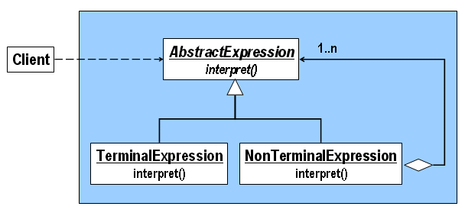
Interpreter: Class Model

Slide 6
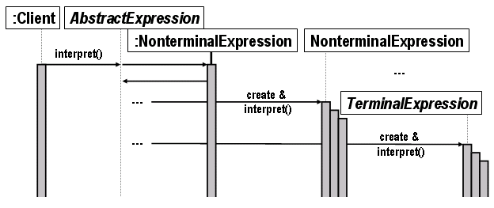
Interpreter: Sequence Diagram

Slide 7

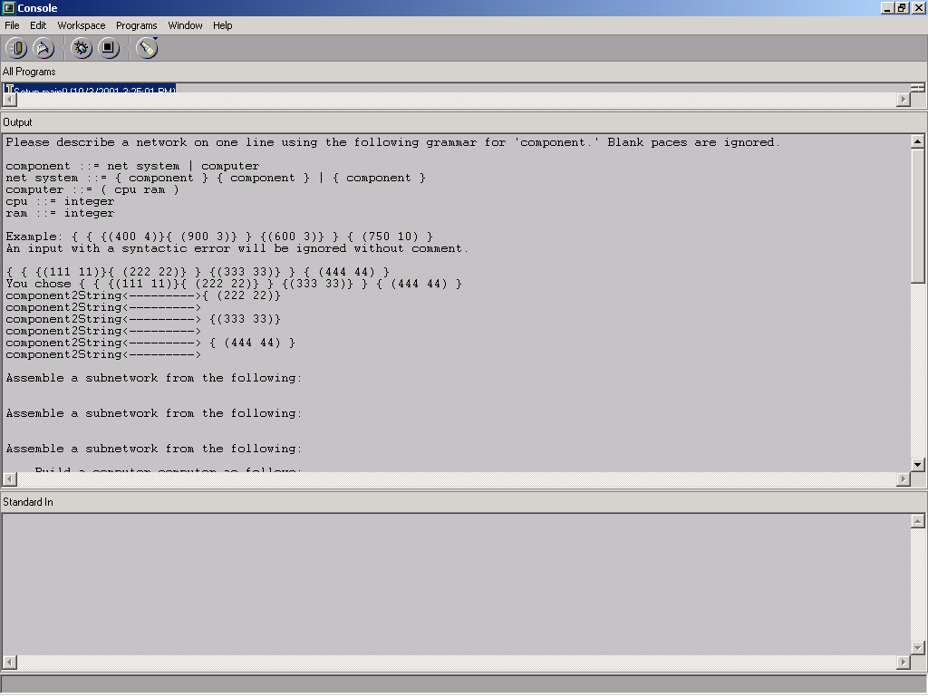
Network Assembly Example

Slide 8
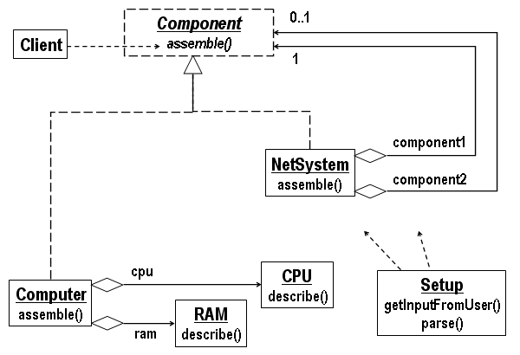
Network Assembly Example (Cont’d)

Slide 9
Comments on Interpreter
It's easy to change and extend the grammar.
Interpreter has features in common with the Composite design pattern.
  They are certainly both in recursive form.
  Composite emphasizes the representation of a data structure (a static viewpoint), whereas Interpreter emphasize the functional viewpoint (interpreting the expression).

Slide 10
Iterator Design Pattern
Design Purpose
  Provide a way to access the elements of an aggregate object sequentially without exposing its underlying representation.
Design Pattern Summary
  Encapsulate the iteration in a class pointing (in effect) to an element of the aggregate.

Slide 11
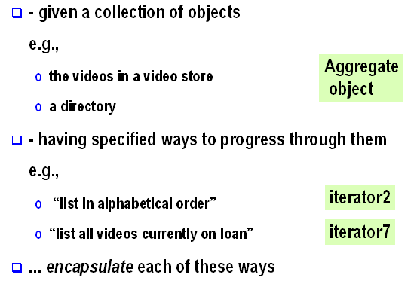
Purpose of Iterator

Slide 12
Functions of Iterator
// Iterator "points" to first element:
void setToFirst();
// true if iterator "points" past the last element:
boolean isDone();
// Causes the iterator to point to its next element:
void increment();
// Return the element pointed to by the iterator:
C getCurrentElement();

Slide 13
Using Iterator Functions
/*
To perform desiredOperation() on elements of the aggregate according to the iteration (order) i:
*/
for( i.setToFirst(); !i.isDone(); i.increment() )
  desiredOperation( i.getCurrentElement() );

Slide 14
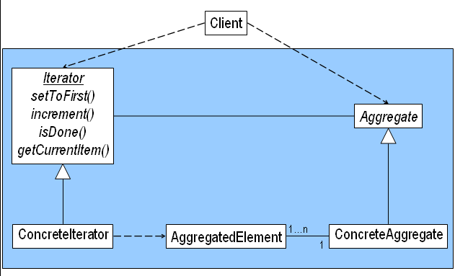
Iterator: Class Model

Slide 15
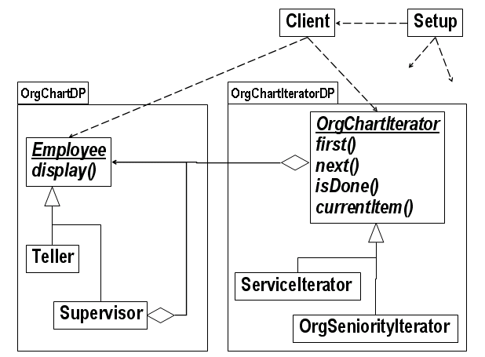
Organization Chart Example

Slide 16
Comments on Iterator
Iterator separates the “visiting” procedure from the processing of individual aggregated elements.
Every collection must have an iterator of one kind or another.
  A collection in which we can not access all of its individual element is useless.

Slide 17
Mediator Design Pattern
Design Purpose
  Avoid references between dependent objects.
Design Pattern Summary
  Capture mutual behavior in a separate class.

Slide 18
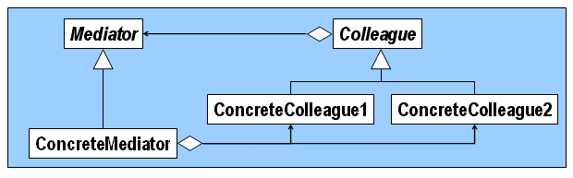
Mediator: Class Model
Mediator design pattern consists of a base class Mediator, each subclass of which encapsulates desired interaction among objects of ConcreteColleague1, ConcreteColleague1 , etc.
All interacting objects belong to subclasses of a base class Colleague that references Mediator.
This ensures that the interacting objects need not know about each other.

Slide 19
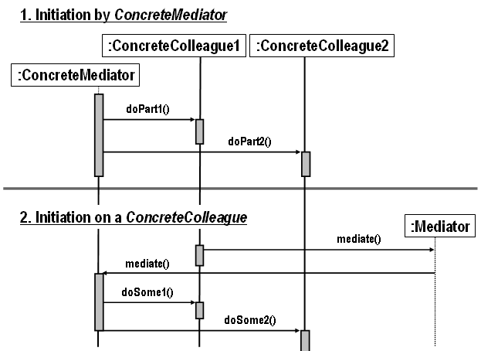
Mediator: Sequence Diagram

Slide 20
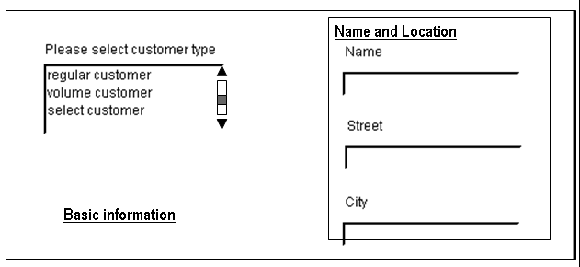
Customer Information Example

Slide 21
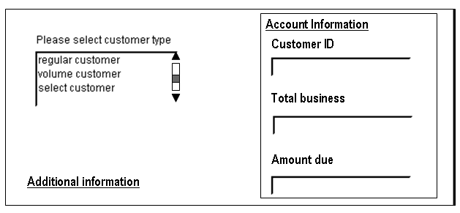
Customer Information Example (Cont’d)

Slide 22
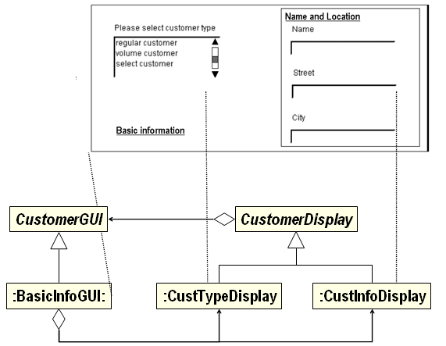
Customer Information Example (Cont’d)

Slide 23
Mediator: Consequences
It decouples colleagues.
It centralizes control.

Slide 24
Observer Design Pattern
Design Purpose
  Arrange for a set of objects to be affected by a single object.
  i.e. keep a set of objects up to date with the state of a designated object.
Design Pattern Summary
  The single object aggregates the set, calling a method with a fixed name on each member.

Slide 25
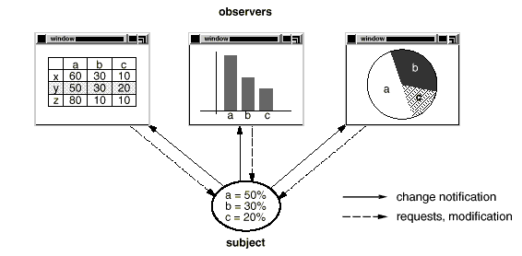
Observer: Motivation

Slide 26
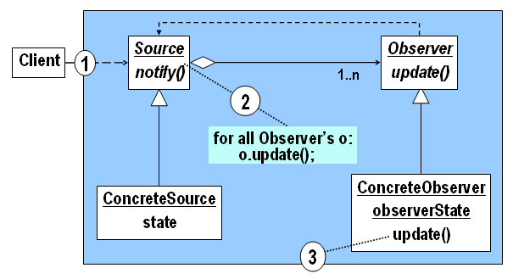
Observer: Class Model

Slide 27
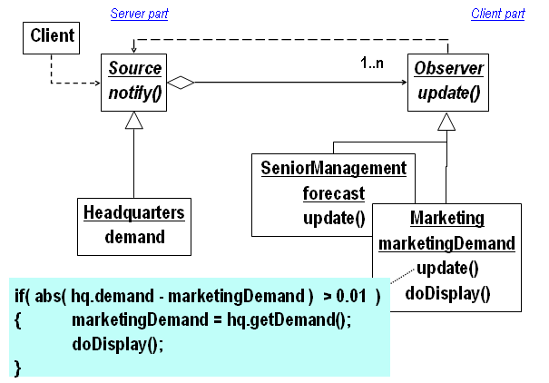
International Hamburger Co. Example

Slide 28
Observer: Consequences
Observer allows the addition and removal of observers without disrupting existing observer code.
Observer may be disadvantageous if very few of the observers need to react to changes (in which case the possibly frequent notifications waste resources).
Observer can’t work if the observable cannot have a reference to all of the observers (in client-server, the server should maintain a reference to all clients)

Slide 29
State Design Pattern
Design Purpose
  Cause an object to behave in a manner determined by its state.
Design Pattern Summary
  Aggregate a State object and delegate behavior to it.

Slide 30
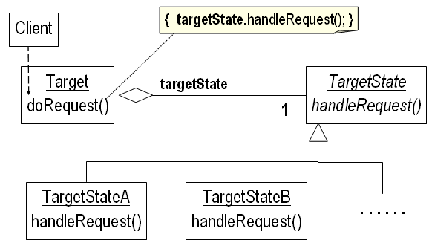
State: Class Model

Slide 31
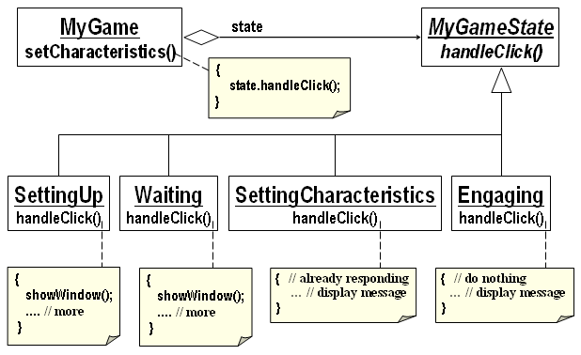
Role-Playing Game Example

Slide 32
State: Consequences
It is particularly beneficial when new states are likely to be needed in the future.

Slide 33
Chain of Responsibility
Design Pattern
Design Purpose
  Allow a set of objects to service a request. Present clients with a simple interface.
Design Pattern Summary
  Link the objects in a chain via aggregation, allowing each to perform some of the responsibility, passing the request along.

Slide 34
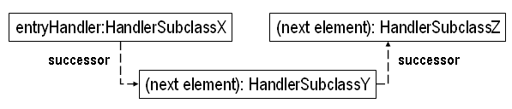
Chain of Responsibility: Object Model

Slide 35
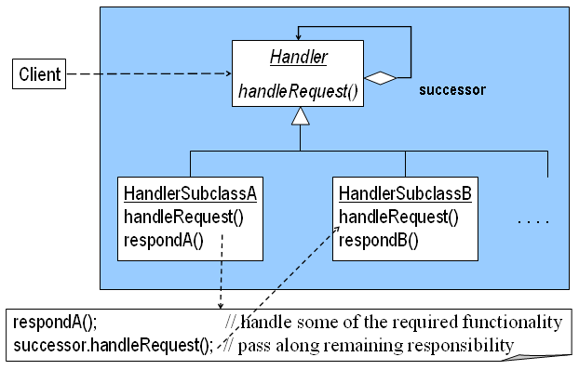
Chain of Responsibility: Class Model

Slide 36
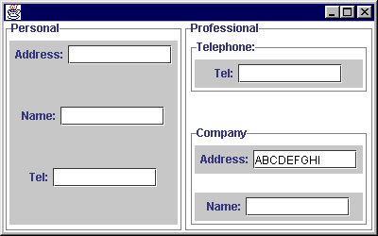
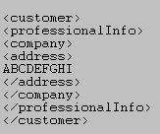
GUI For Customer Information Application

Slide 37
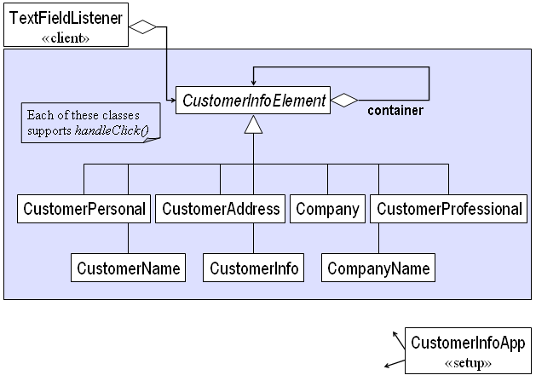
Class Model For User Information Collection

Slide 38
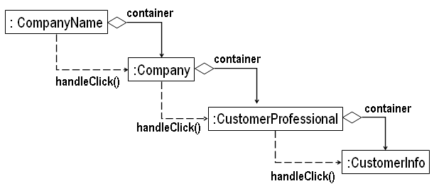
Object Model Fragment for Customer Information Example

Slide 39
Chain of Responsibility: Comments
The class model for Chain of Responsibility is very similar to Decorator. The difference is in the viewpoint taken:
  Decorator emphasizes the structural value of stringing objects together, primarily the static viewpoint.
  Chain of Responsibility emphasizes the dynamic viewpoint: sharing functionality among a community of objects.
The difference between the Chain of Responsibility and Decorator is that the principal aggregation in Decorator is with the base class whereas the aggregation is with the class itself in the case of Chain of Responsibility
Chain of Responsibility has flexibility in that one can easily add or remove functionality from the collective group responsibility.

Slide 40
Command Design Pattern
Design Purpose
  Increase flexibility in calling for a service e.g., allow undo-able operations.
Design Pattern Summary
  Capture operations as classes.

Slide 41
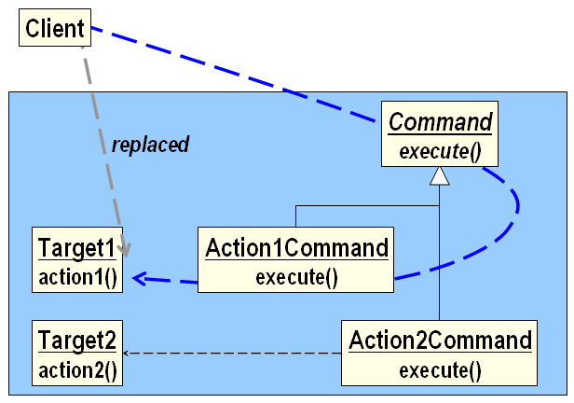
Command: Class Model

Slide 42
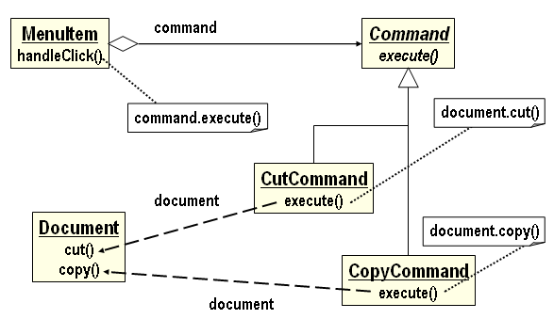
Menu Example

Slide 43
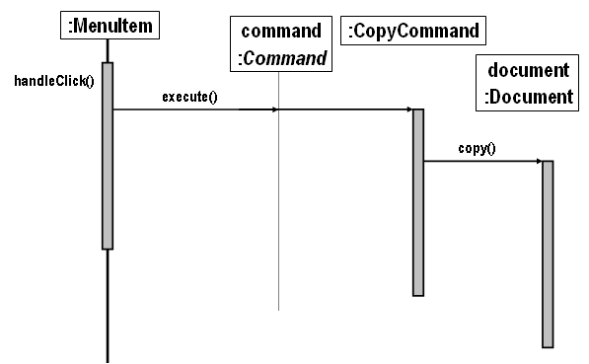
Menu Example (Cont’d)

Slide 44
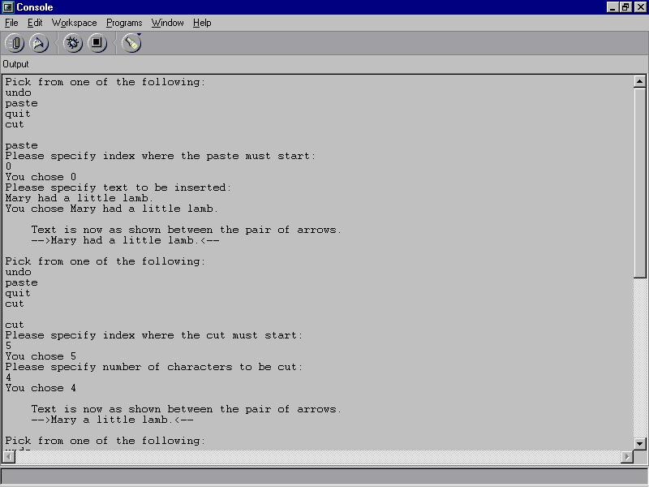
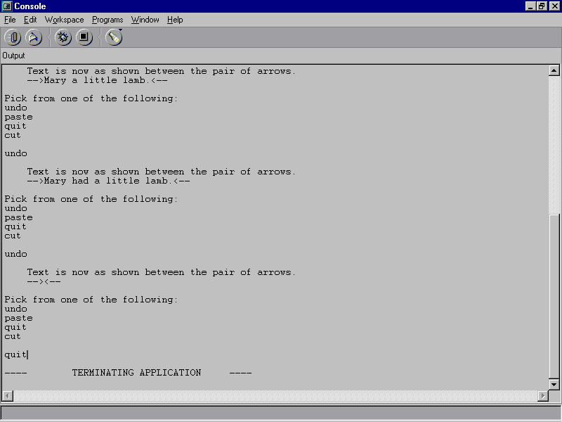
Undo Example

Slide 45
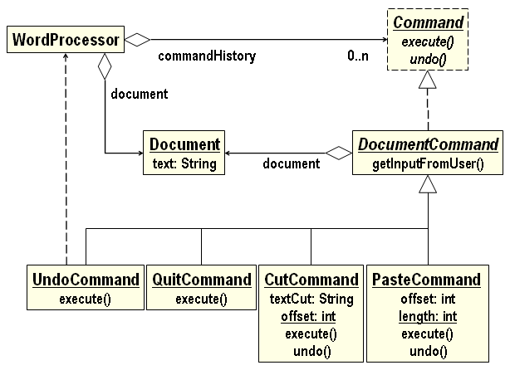
Undo Example: Class Model

Slide 46
Comment on Command
We use Command whenever a method call alone is not sufficient: the ability to undo a command is one reason.
Menus often have submenus, sub-submenus or even more levels of menus.
  This means that there is a hierarchy of commands (a paste, special kind of paste, etc.).
  This hierarchy translates directly into an inheritance hierarchy of Command classes.

Slide 47
Command: Consequences
Command affords us flexibility in dealing with operations, making it easier to modify, isolate, remove, or add operations to an application.
Command promotes modularity, and thus correctness and reusability, because is separates functionality (e.g. a cut operation) from the object to which the functionality applies (e.g. a document whose text is to be cut).
One downside of using Command is the fact that, as is common with design patterns, we are replacing what would be a single function call with multiple function calls.

Slide 48
Template Design Pattern
Design Purpose
  Allow runtime variants on an algorithm.
Design Pattern Summary
  Express the basic algorithm in a base class, using method calls where variation is required.

Slide 49
Example of Template Motivation
Required to solve equations of the form
  ax² + bx + c = 0.
Must be able to handle all input possibilities for a, b, and c.
This is a tutorial application that must provide full explanations to users about the solutions for all values for a, b, and c.

Slide 50
A Basic Quadratic Algorithm
Report progress
Display number of solutions
Display first solution, if any
Display second solution, if any

Slide 51
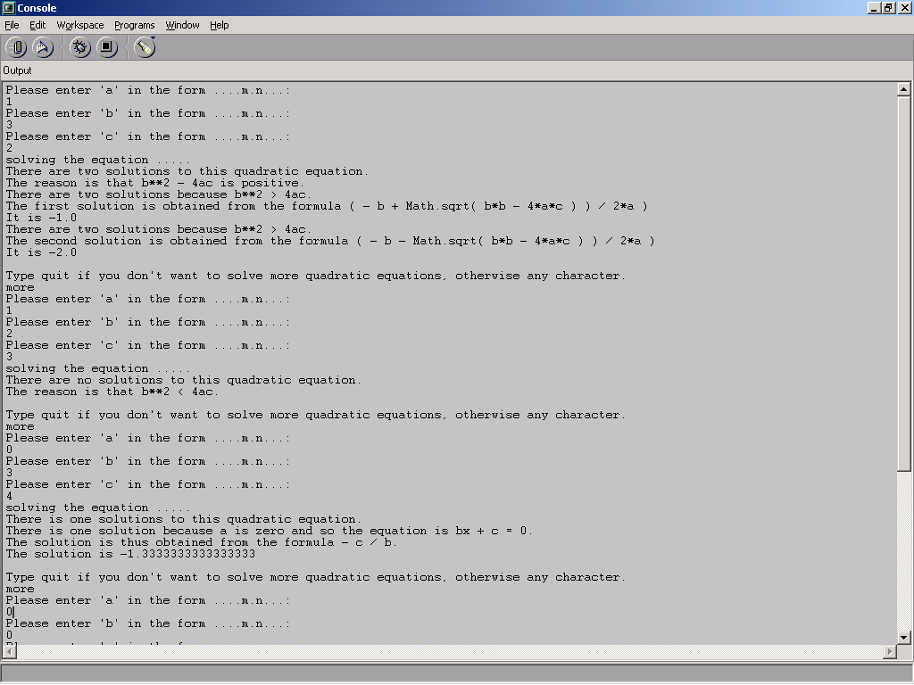
I/O For Quadratic Example

Slide 52
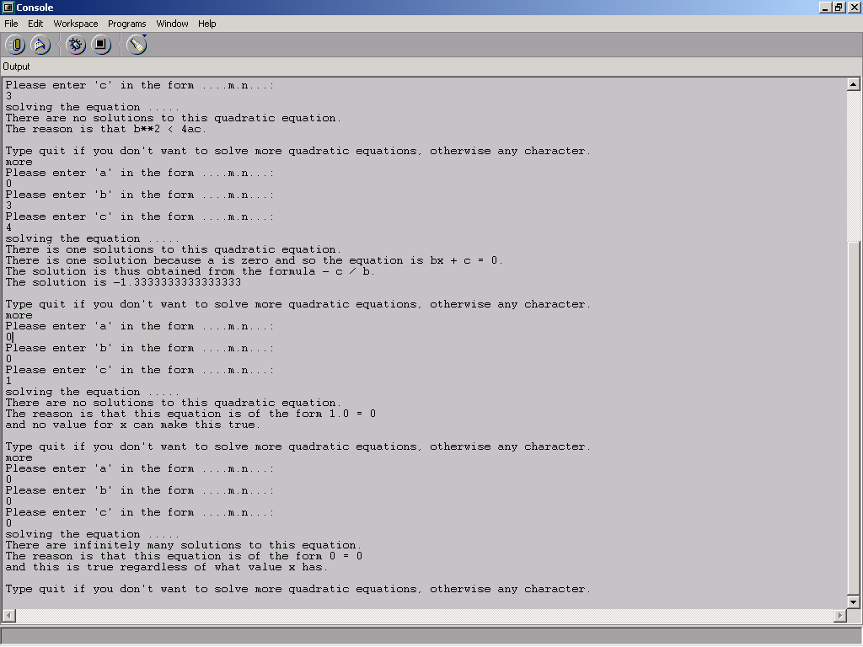
I/O For Quadratic Example (Cont’d)

Slide 53
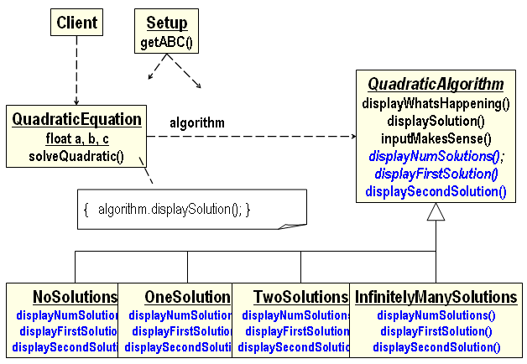
Class Model for Quadratic Problem

Slide 54
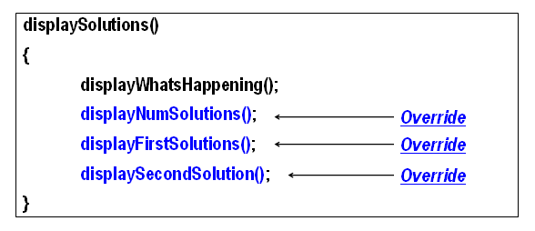
Quadratic Display Algorithm

Slide 55
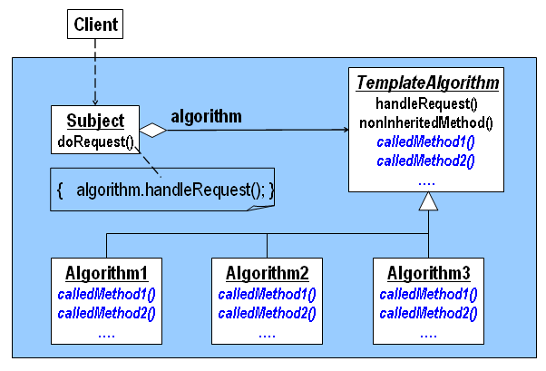
Template: Class Model

Slide 56
Template: Consequences
Template promotes modularity (and thus correctness and reusability) by separating the core of a set of algorithms from its variants.
The downside of using Template is the usual one with design patterns: We are introducing additional function calls, which reduces time efficiency.
By separating algorithms into a hierarchy, we promote modularity (and thus the ability to verify the design correctness), maintainability (keeping track of the various algorithms more effectively) and flexibility (allowing us to change algorithms easily).

Slide 57
Summary of Behavioral Patterns
Behavioral Design Patterns capture behavior among objects:
  Interpreter handles expressions in grammars
  Iterator visits members of a collection
  Mediator captures behavior among peer objects
  Observer updates objects affected by a single object
  State allows method behavior to depend on current status
  Chain of Responsibility allows a set of objects to provide functionality collectively
  Command captures function flexibly (e.g. undo-able)
  Template captures basic algorithms, allowing variability

